Slide 1
Analysis of flats resale prices in singapore
Tan Wen Tao Bryan (p2214449)

Slide 2
Objective
To find out the best valued flat type a person should purchase as well as, to find out which town to buy it in based on one’s budget and preference.

Slide 3
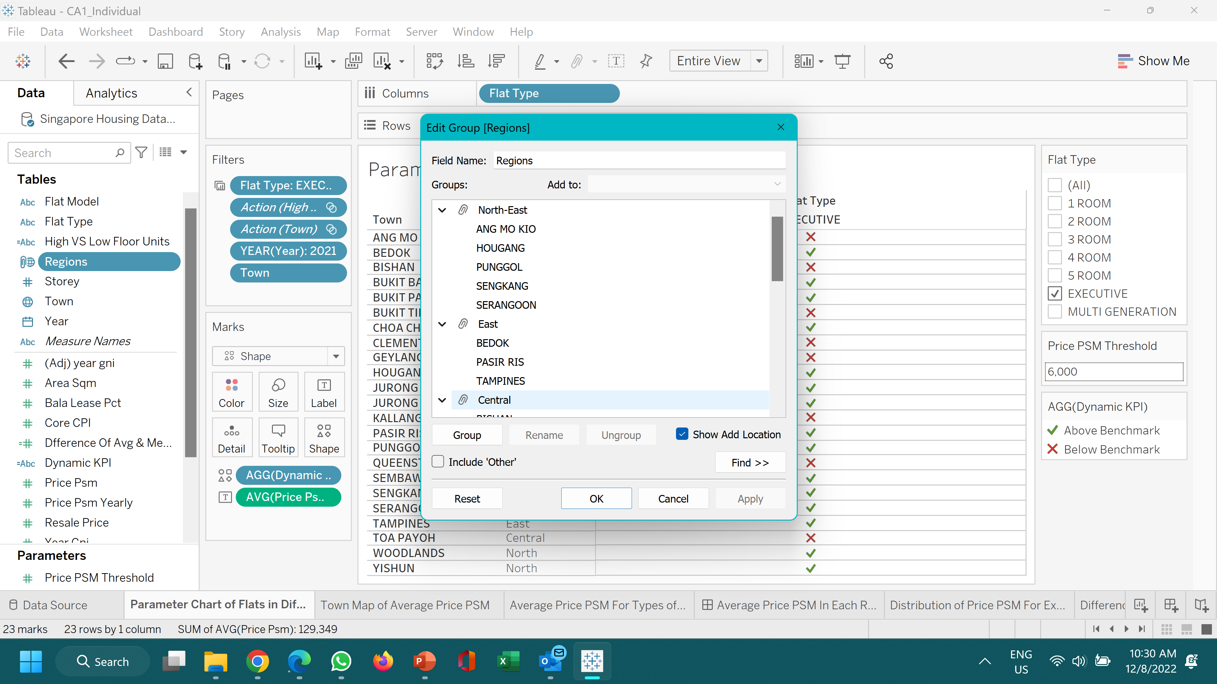
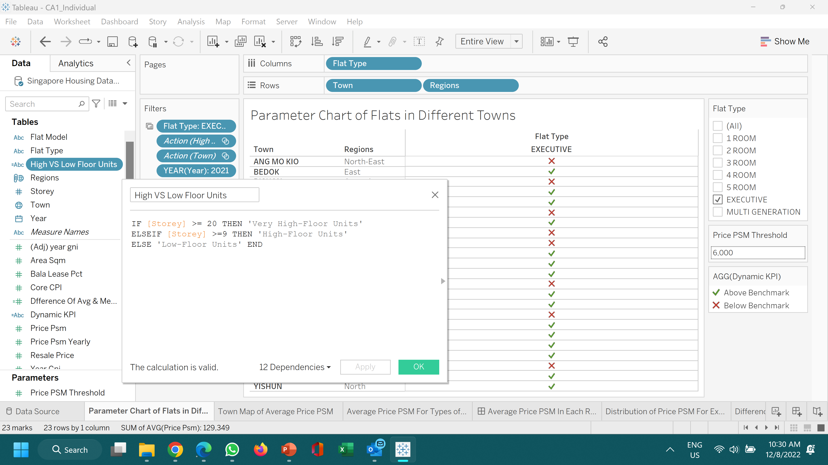
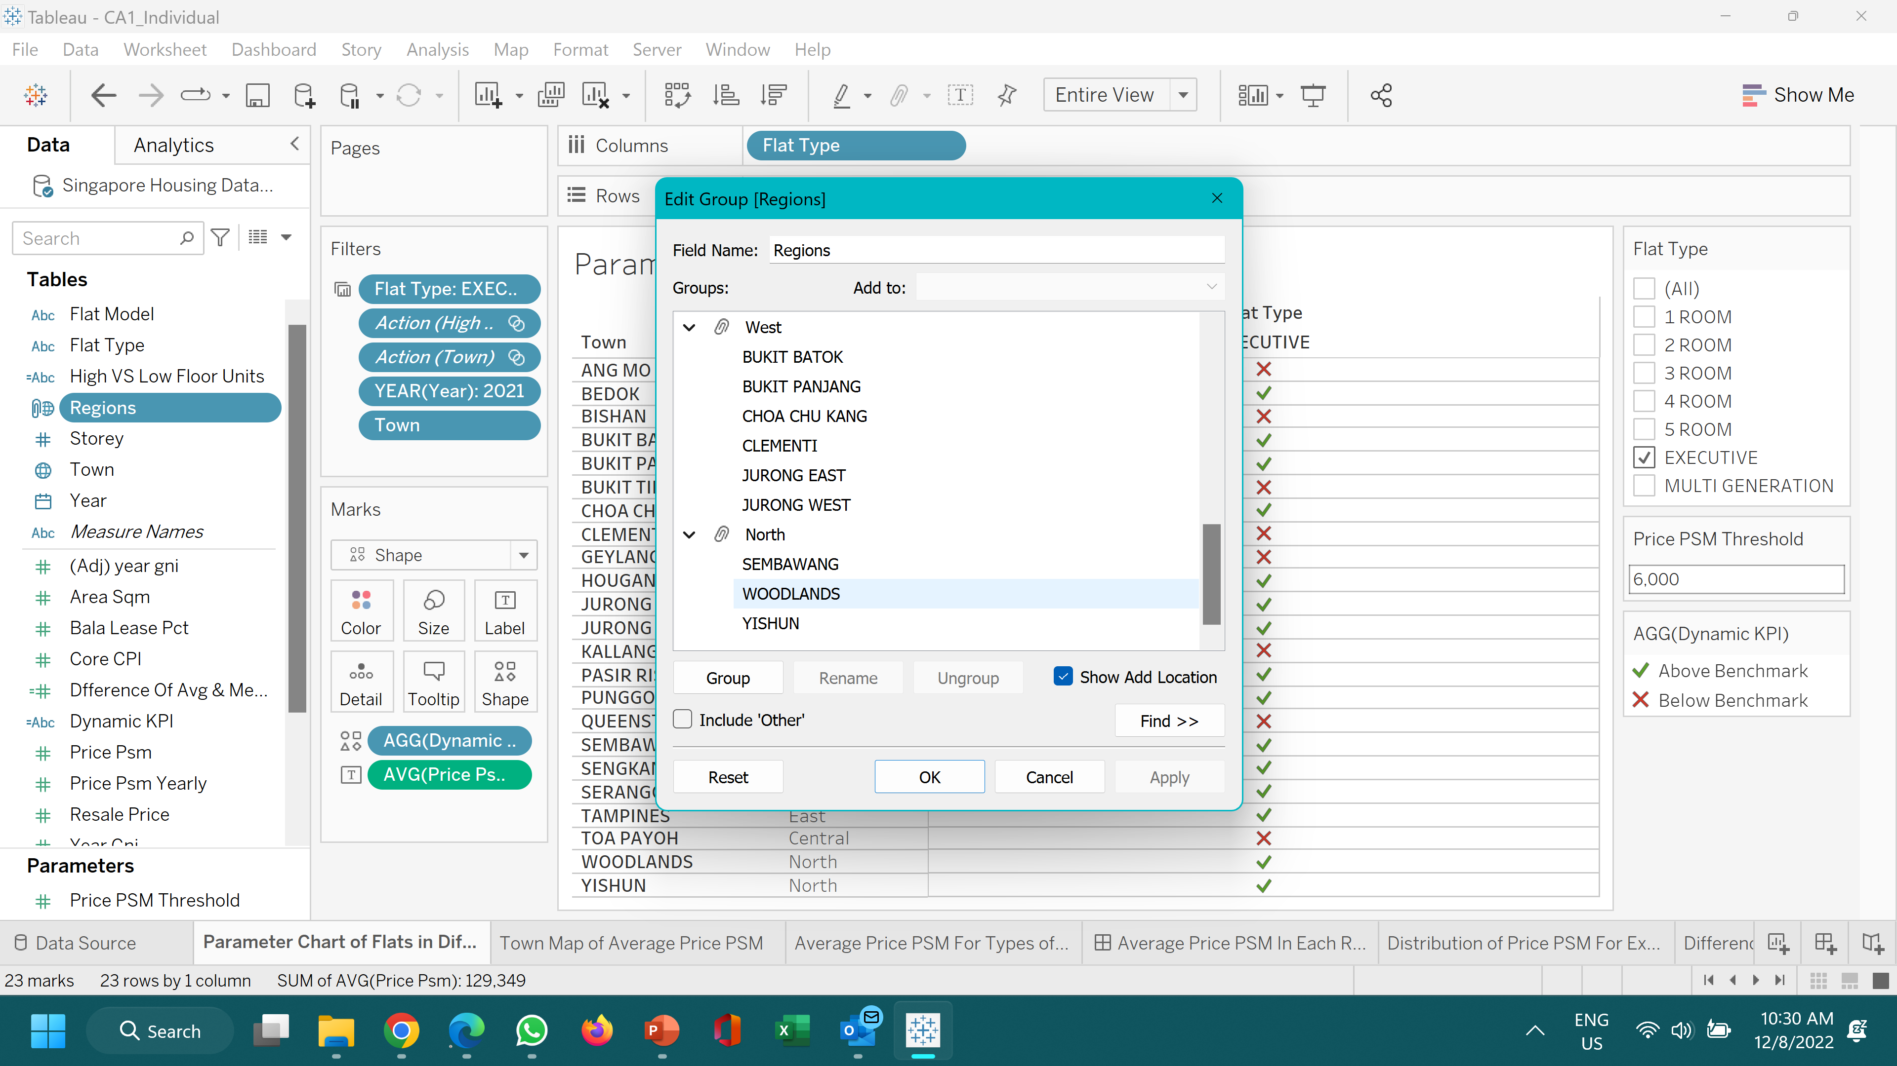

Cleaning dataset Using MS Excel
Delete unused columns: year, latitude, longitude, town dummy, block, street name, address, storey range, non-adjusted resale price and price psm, lease start, lease rem
Delete rows from 1990-2010: To focus on the latest 10 years, shorten the focus on these times
Rename data fields: Replace underscores with spaces in Excel, rename months as years, rename price cpi_lease_adj implied as resale price, rename price_psm_cpi_lease_adj implied as price psm
Formulated a new column: Adjusted Year GNI (Unadjusted Year GNI x 100/Core CPI)

Slide 4
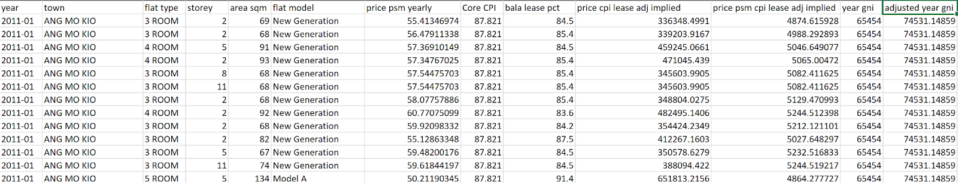
Nature of Cleansed Dataset
Housing dataset
209536 rows and 13 data fields
Columns: year, town, flat type, area sqm, flat model, price psm yearly, core CPI, bala lease PCT, resale price, price psm, year GNI, adjusted year GNI
Adjusted year GNI: year GNI after considering Core CPI
Flat type: 1-room, 2-room, 3-room, 4-room, 5-room, Executive, Multi-Generation
Price psm cpi lease adj implied: Price psm after considering CPI & remaining lease

Slide 5
Case Scenario
Mr David just immigrated to Singapore and he is thinking of buying a new flat to move into with his wife and son, Andrew. Before purchasing a new flat, he wishes to find out which town or region suits his budget the most. Mr David wants to purchase a flat that is about $6000 per square metre. Mrs David also want a high-floor unit with a balcony so that they can spend their night romancing under the moonlight and breathing in the picturesque landscape. They want to seek the best flat type their money can buy and also want to know which town they should move in to.

Slide 6
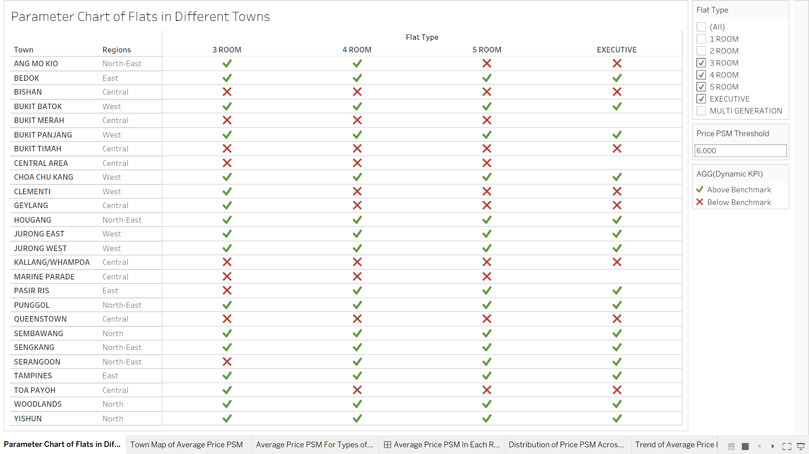
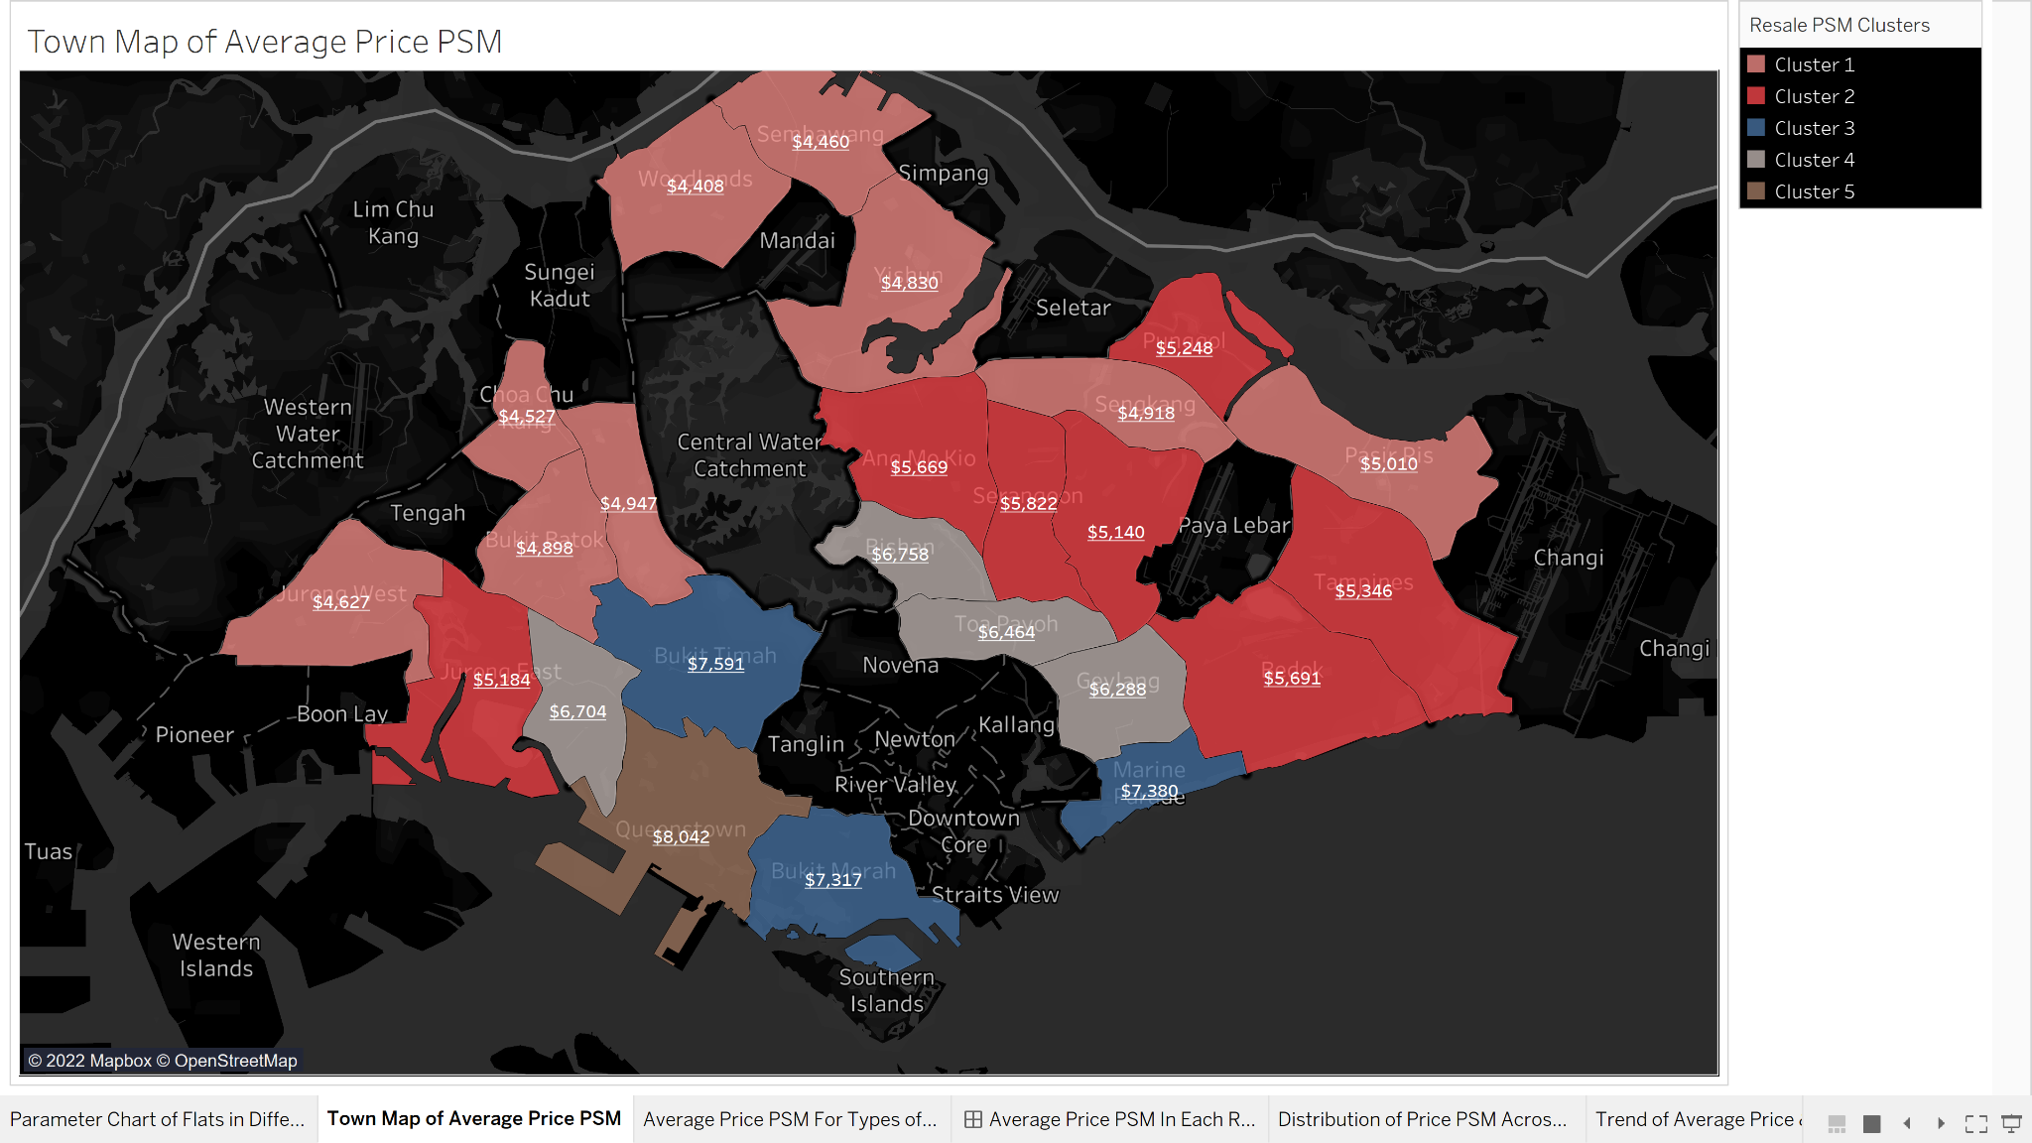
More Expensive flats are in the Central Area
In the parameter chart, ticks represent the type of flat that Mr David can afford based on his budget.
In the map, the more expensive flats are located all in the Central region as the blue, grey and brown regions are all clustered there, with Queenstown being the most expensive.
The more affordable flats are all located around the West, North and even some parts of North-East regions as the light red regions are clustered there.

Slide 7
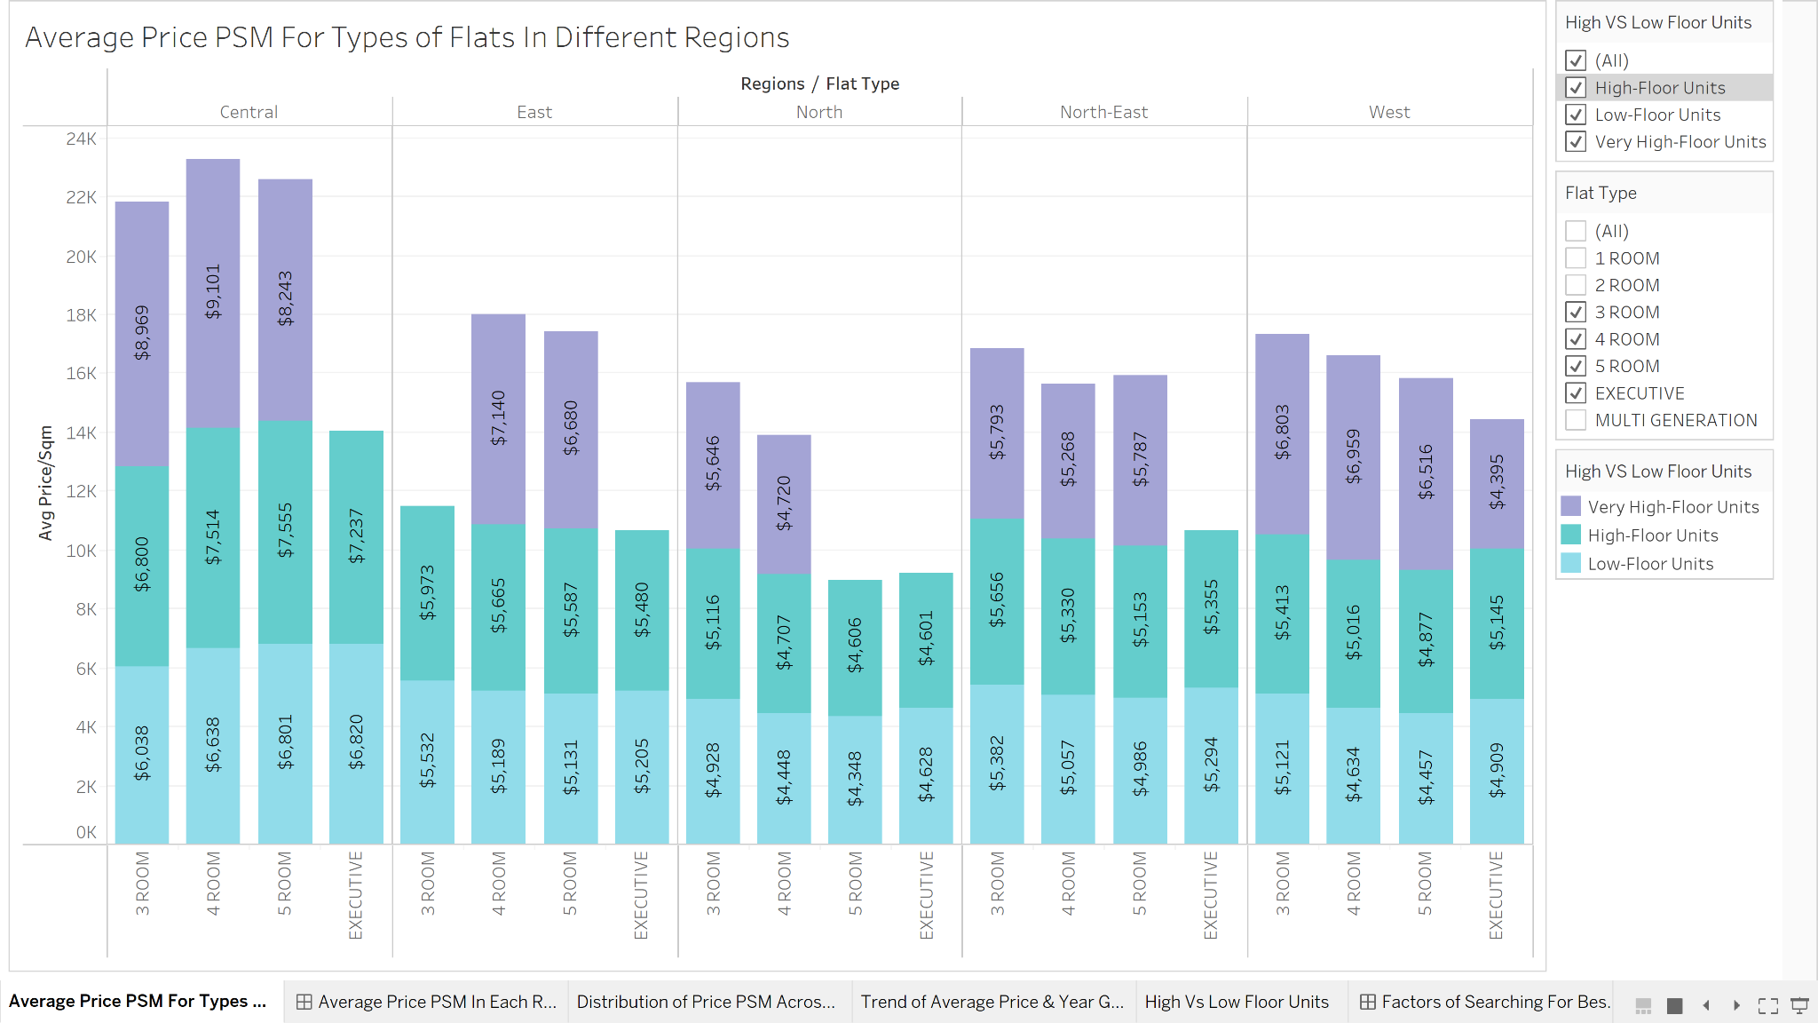
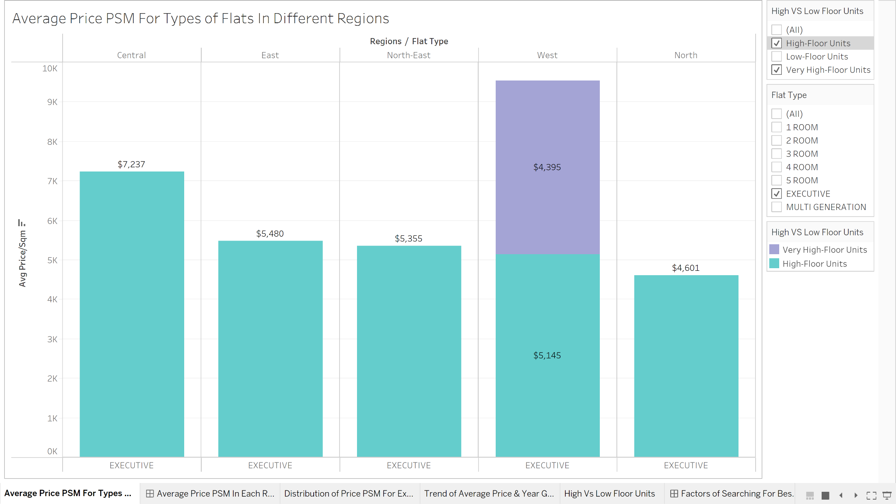
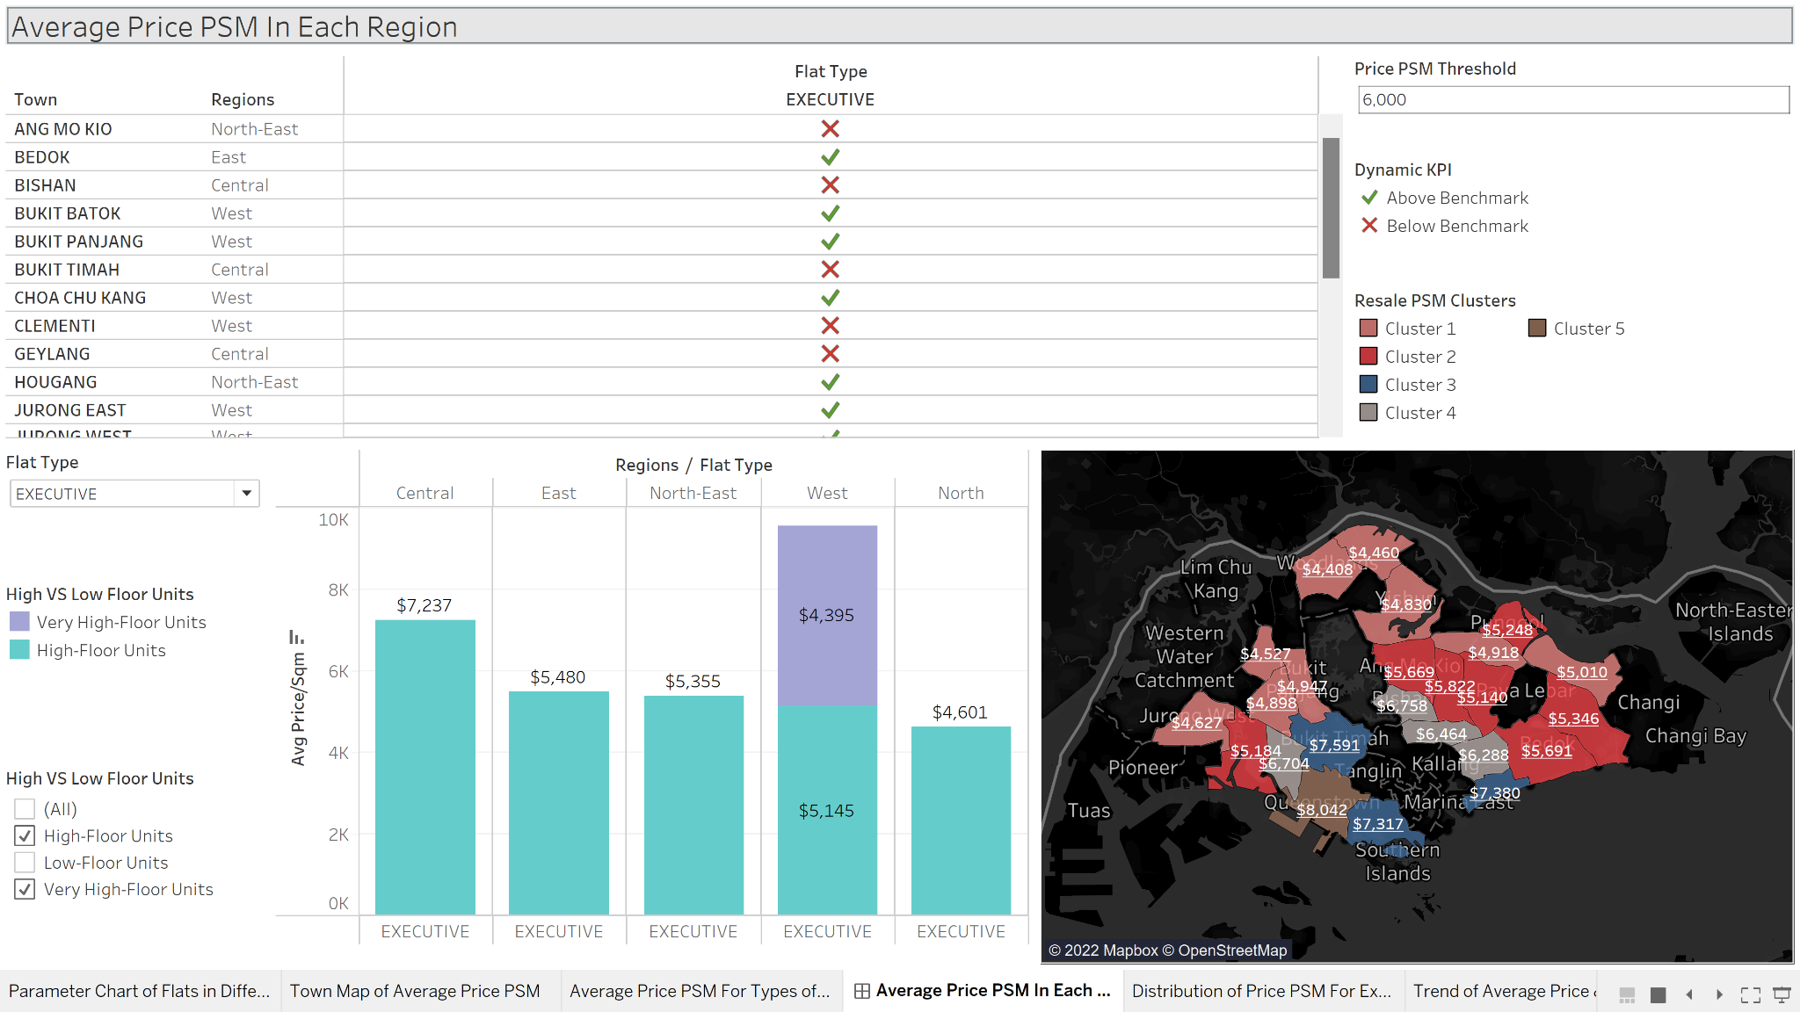
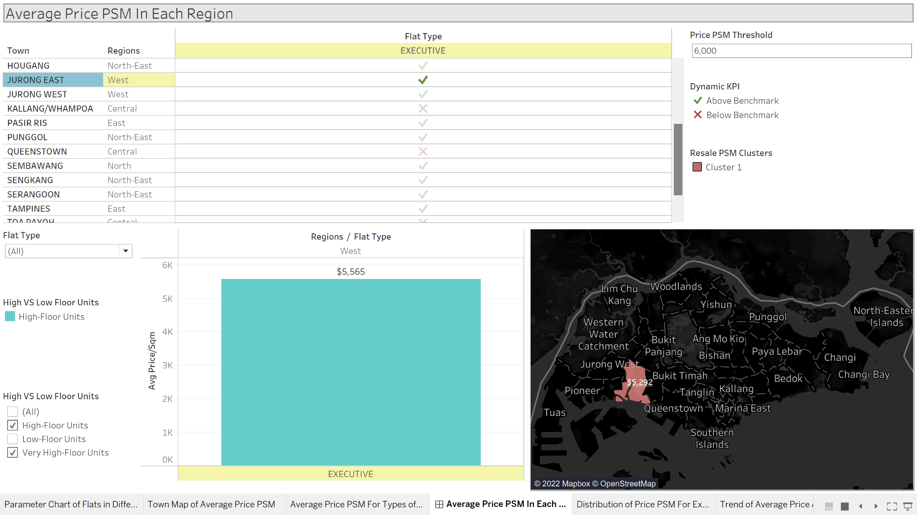
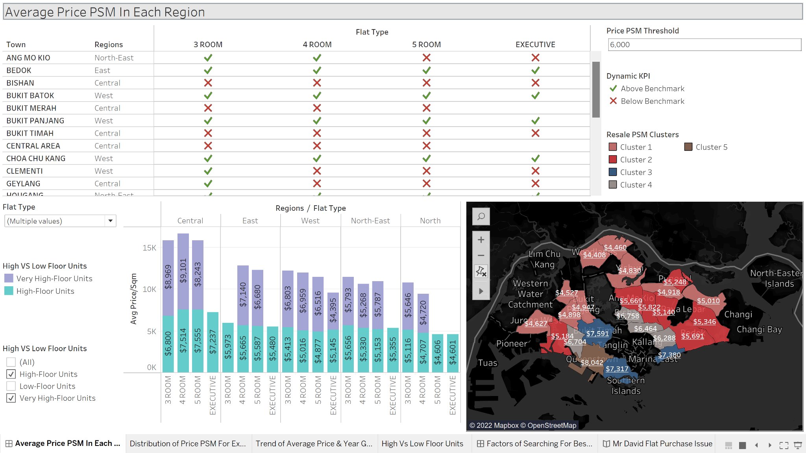
Towns With Flats That Are Within Mr David’s Budget
Average price of the flats per square metre are relatively the highest in the Central region while relatively lowest in the North region.
Just by comparing high and very-high level floor for executive flats, the flats in the North region are the cheapest while flats in the Central are the most expensive.
The charts shows the towns which the price psm of high-floor executive flats are within Mr David’s budget.
Examples include: Choa Chu Kang, Jurong East, Punggol, Woodlands, Pasir Ris and Sembawang

Slide 8
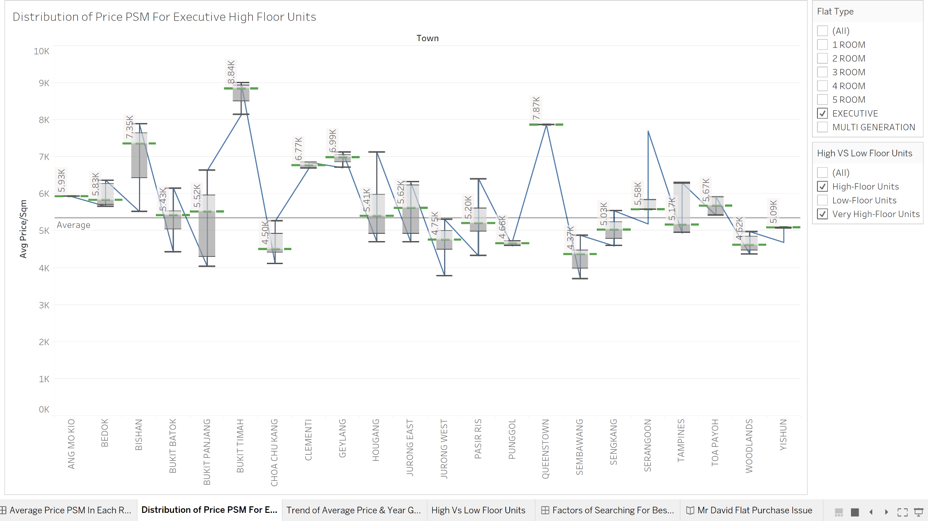
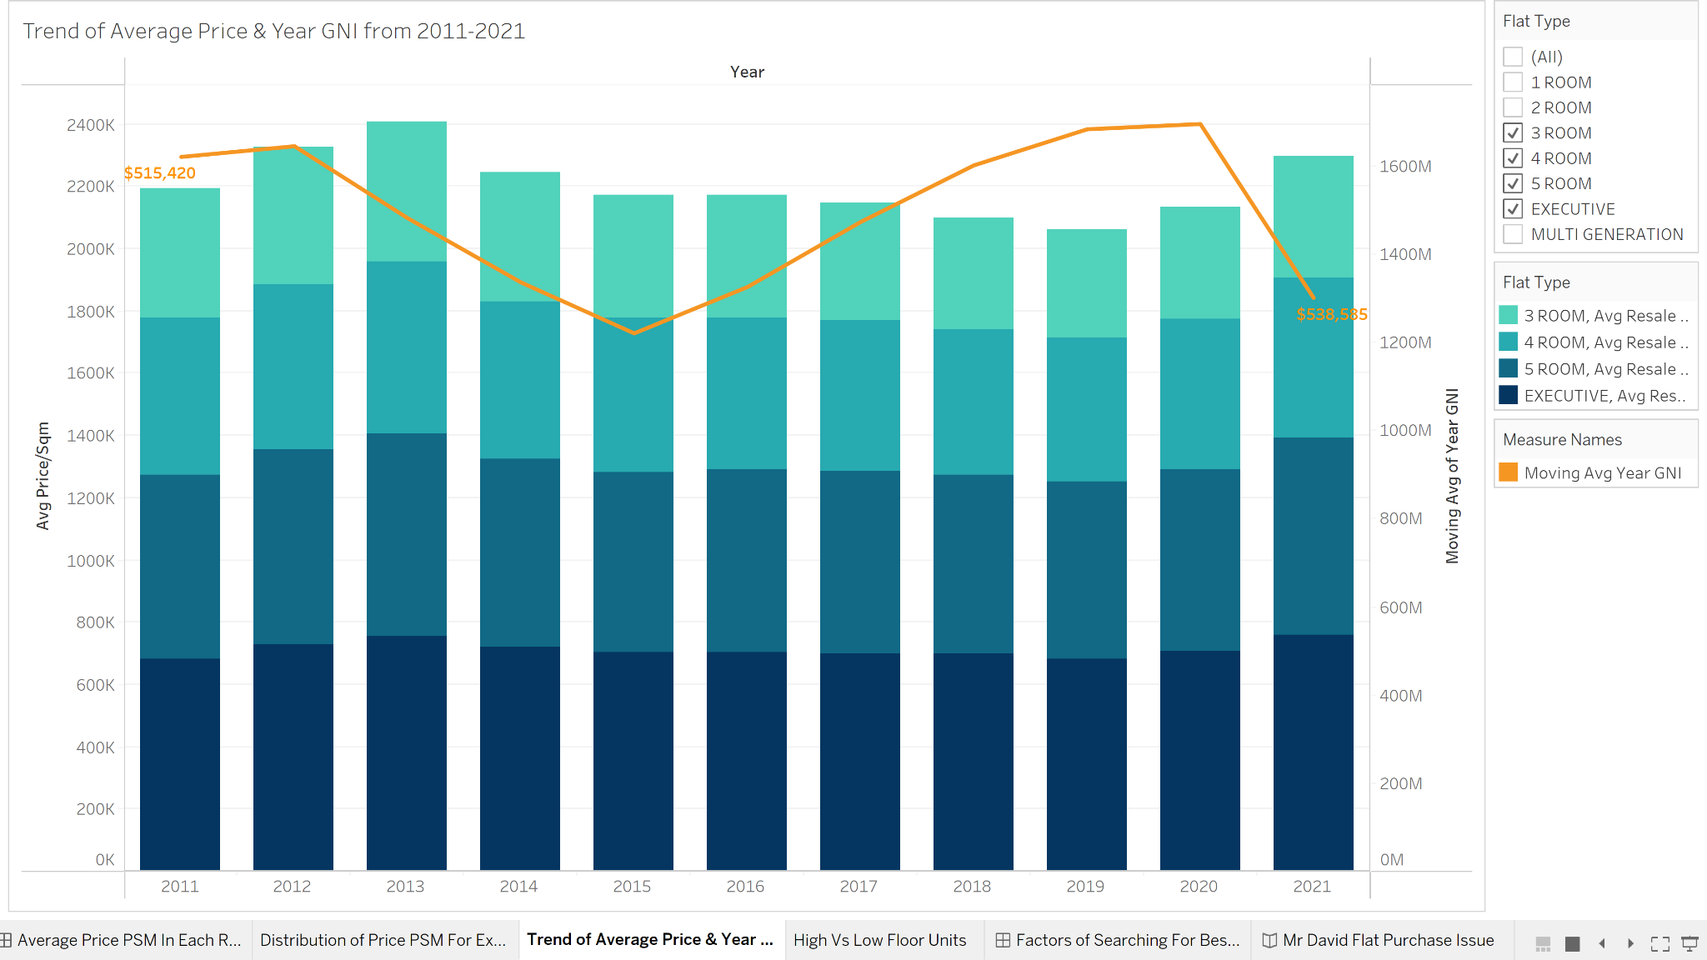
Sembawang HAs the Lowest Median Flat Price PSM
By comparing only executive high-level flats, Bukit Timah has the highest median flat price psm while Sembawang has the lowest median flat price psm.
Towns like Serangoon and Yishun have flats which price psm have outliers where a small group of flats are either more expensive or cheaper than the majority.
Generally, there is an increasing trend in the average price for each type of flats and a decreasing trend in the year GNI from 2011-2021. Flats need to be purchased quickly or else the flat prices will keep increasing.

Slide 9
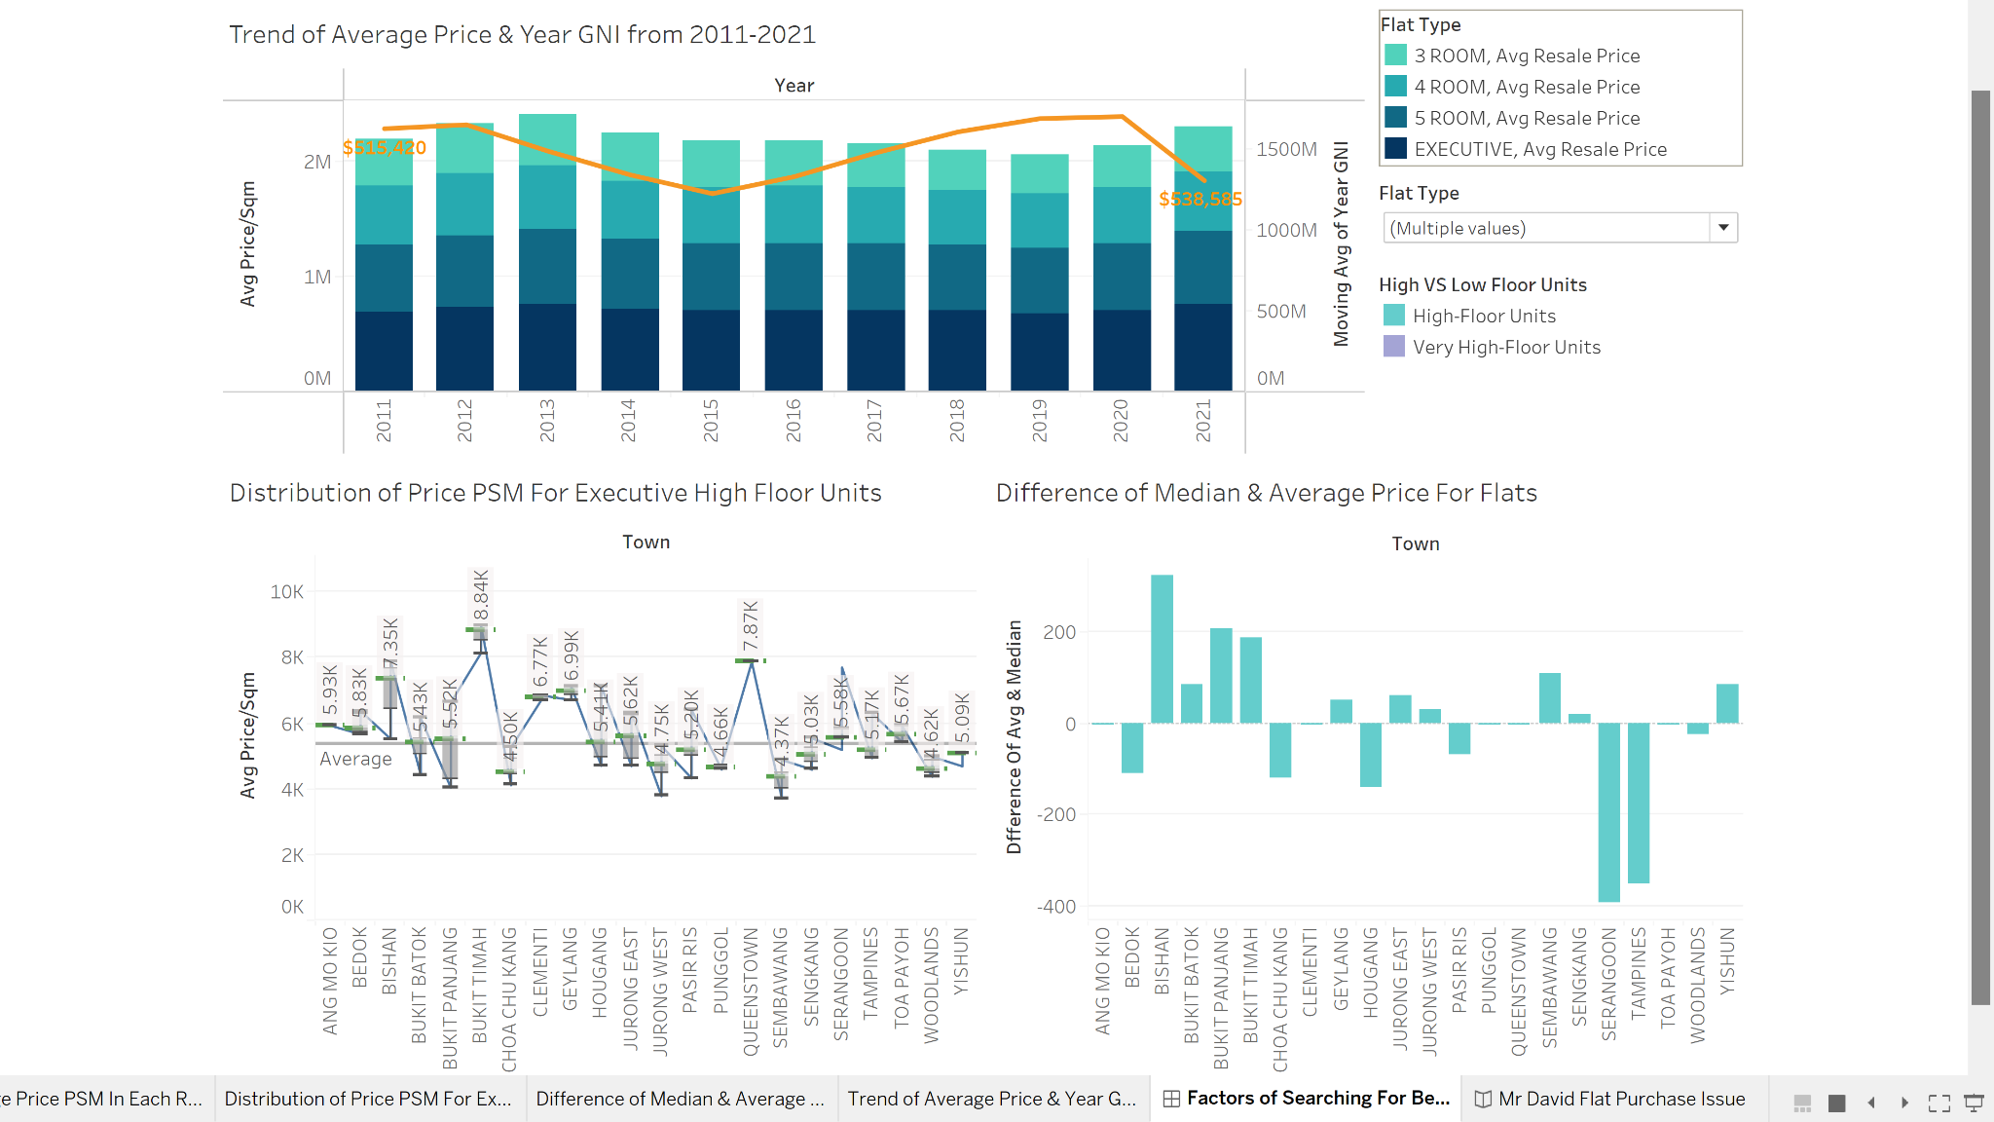
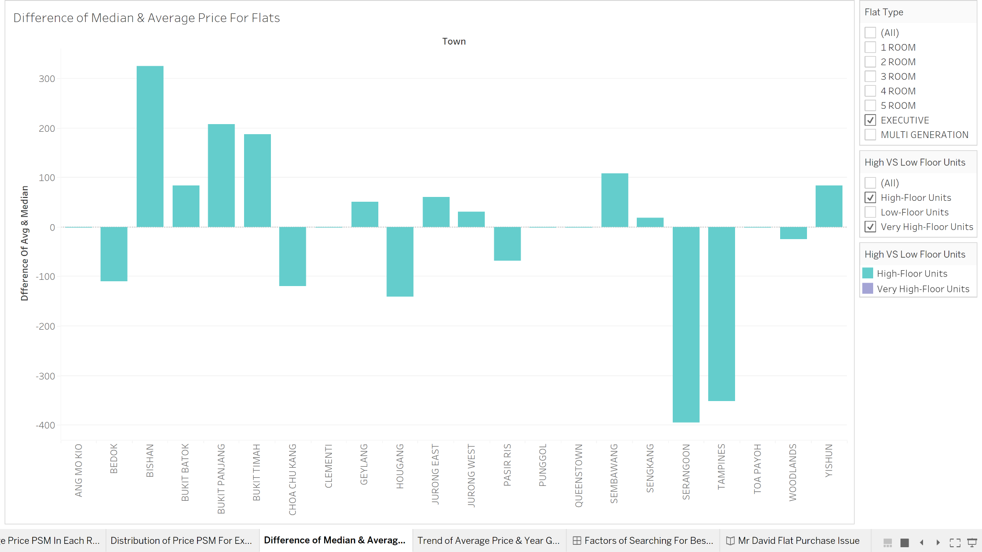
Bishan Has Highest DIfference of Median And Average Price PSM
Comparing only executive high-level flats, Bishan has the highest difference for the median and the average flat price psm.
If the value is positive, it means that the median price psm is higher than its average price psm, otherwise, it is lower.
However, the highest difference does not mean that it is the most affordable flat in that area. It fails to consider whether the price is within Mr David’s budget and most valued compared to other areas.
Hence, we have to do an overall comparison with the other graphs to find out the most valued high-level executive flat.

Slide 10

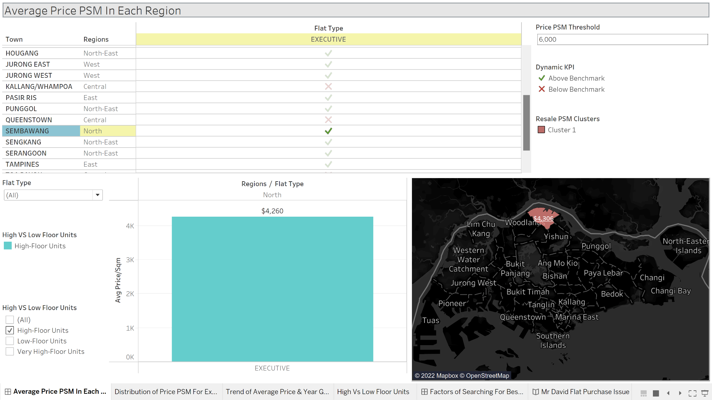
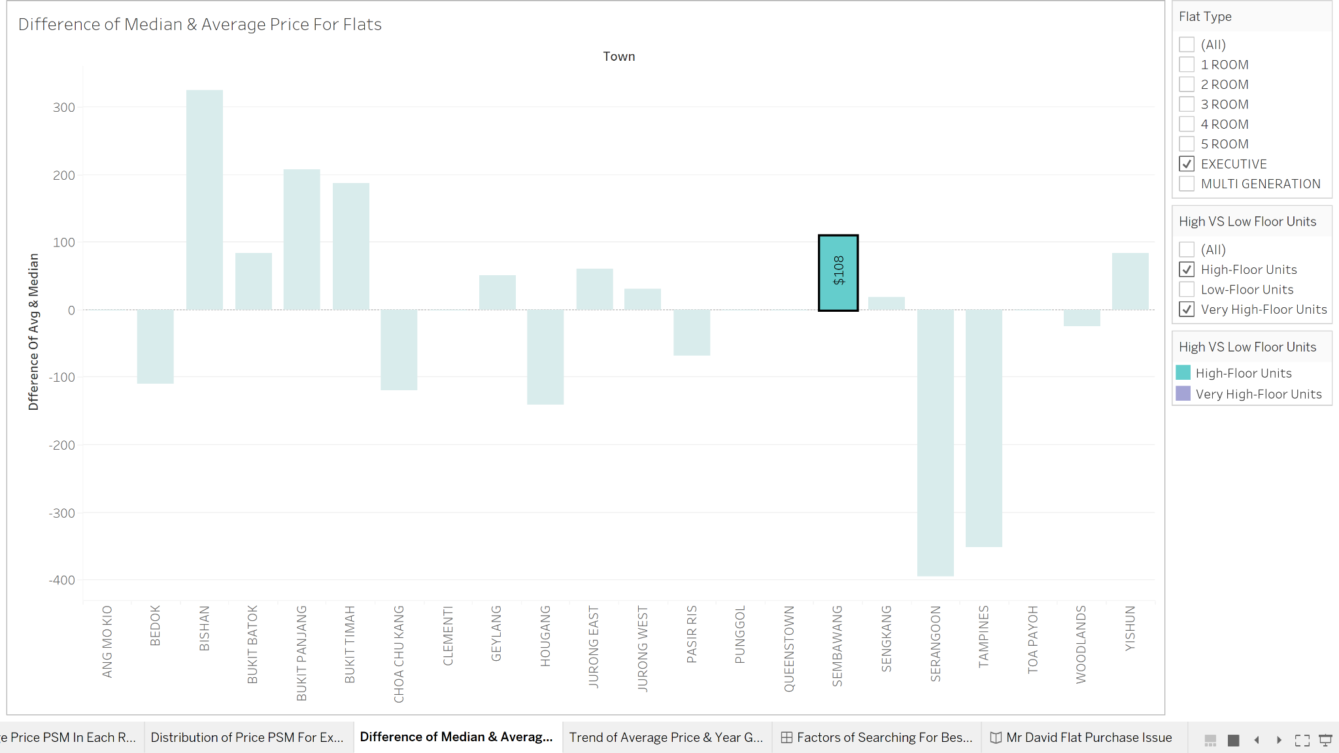

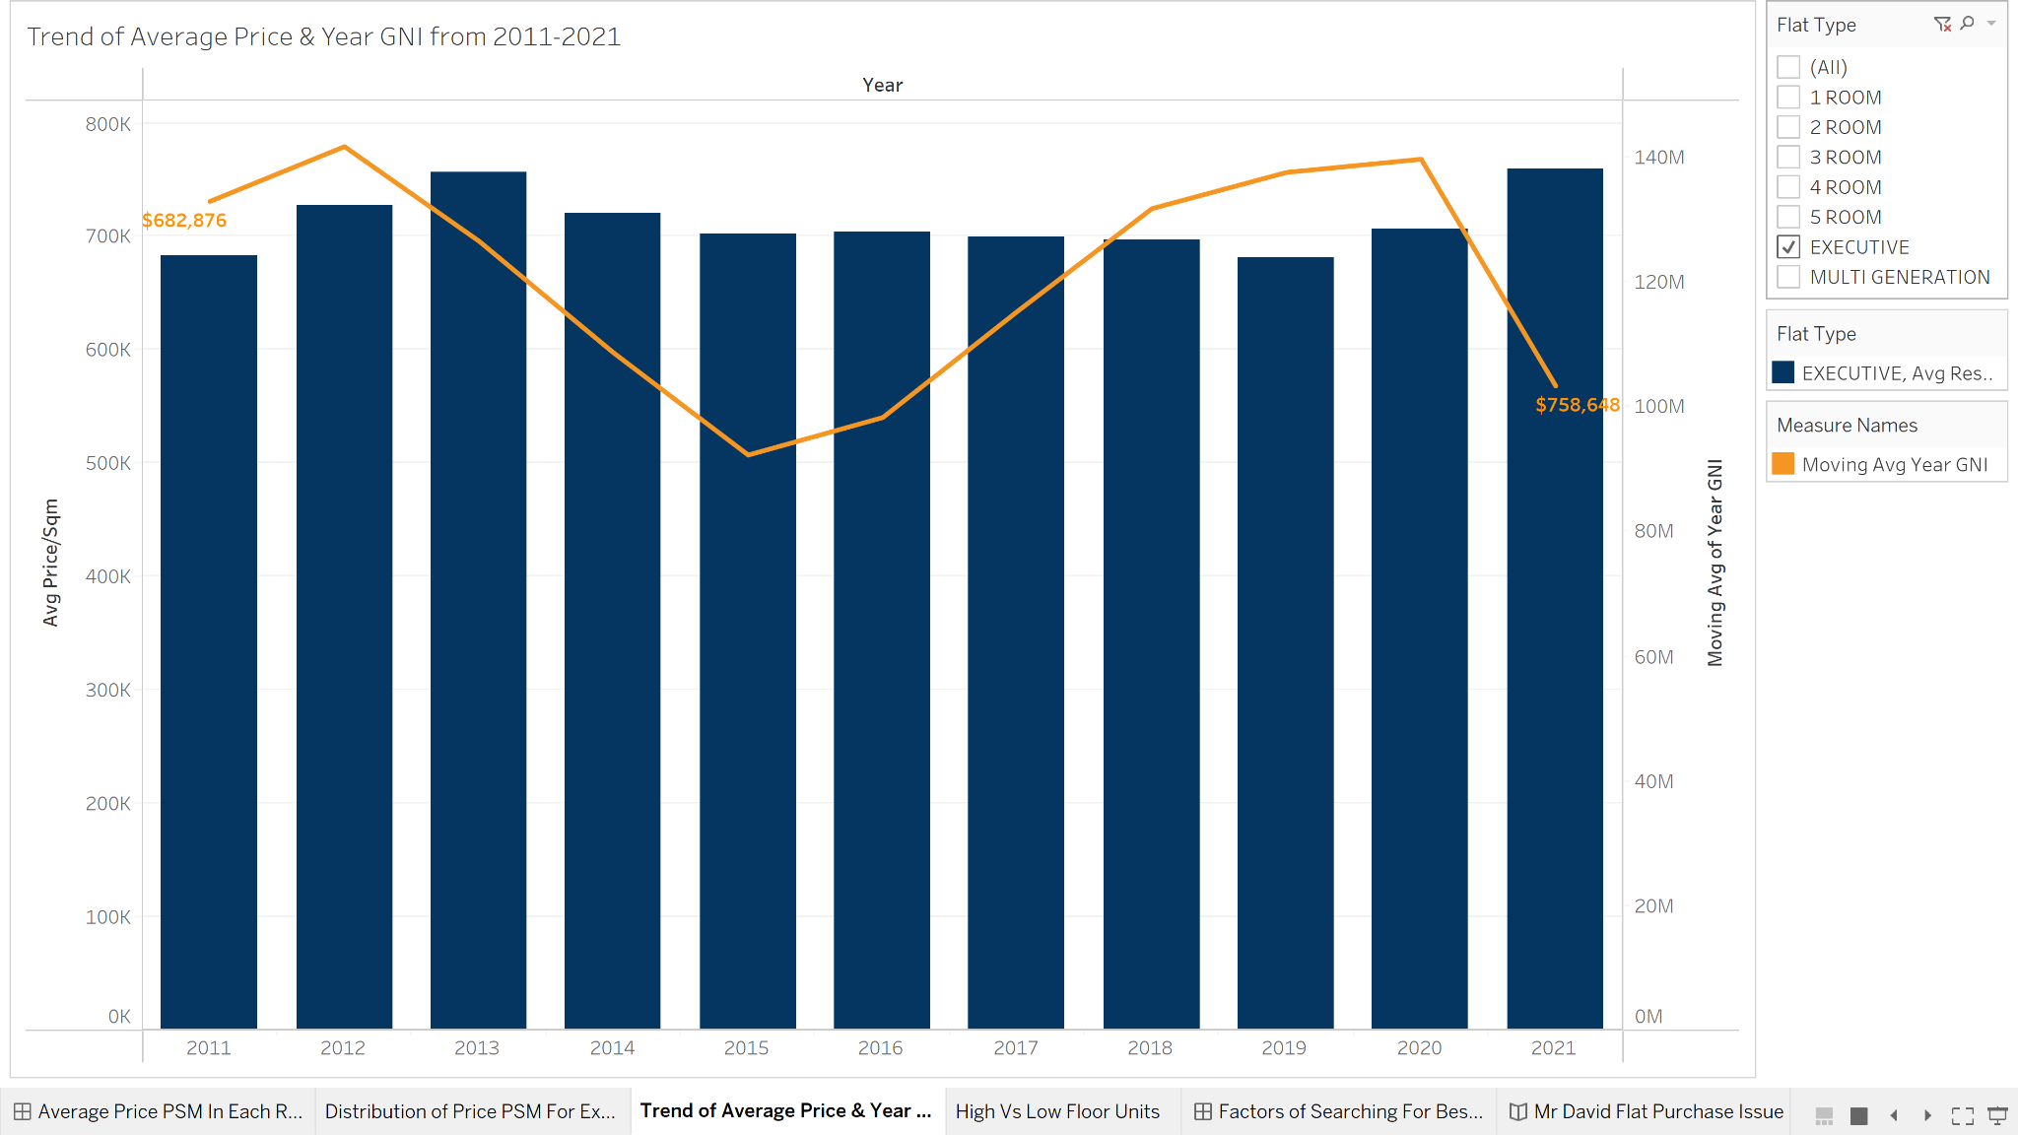
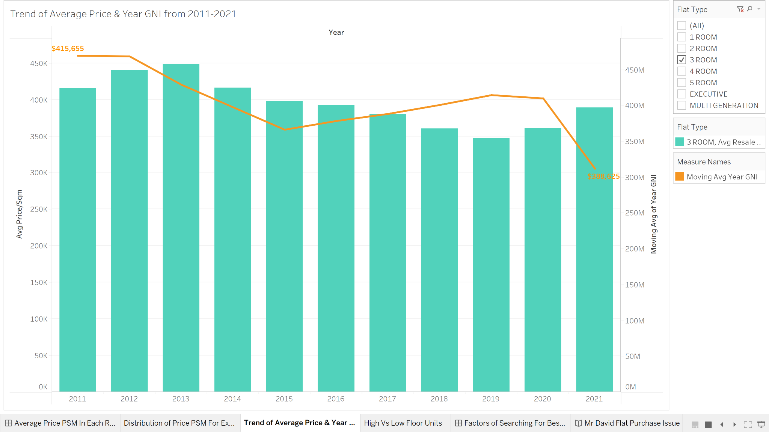
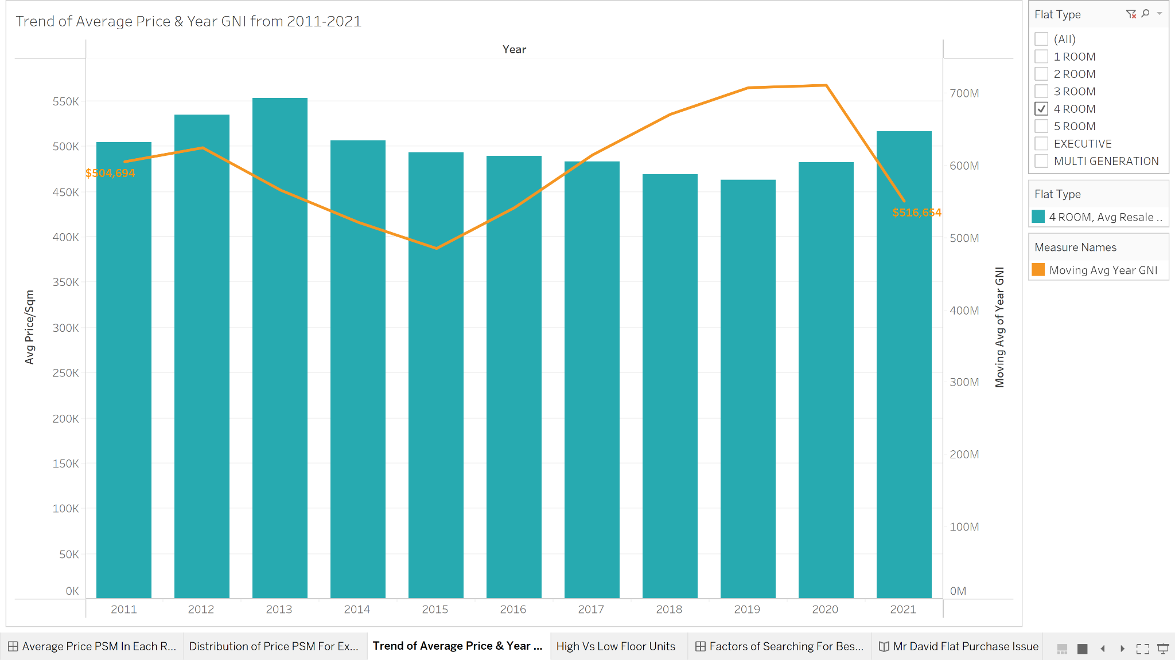
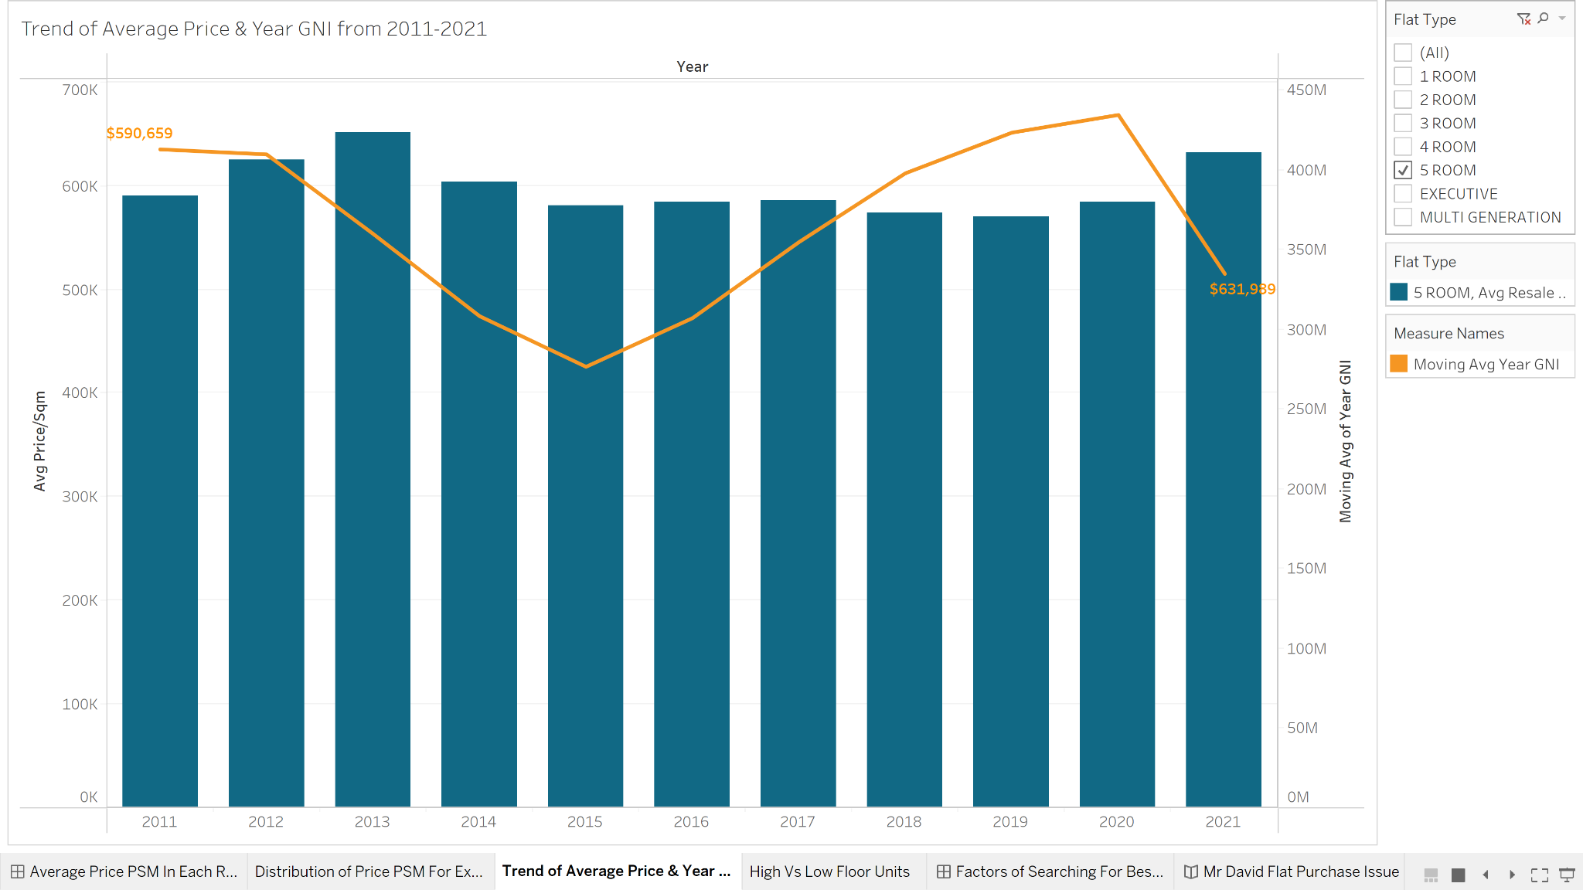
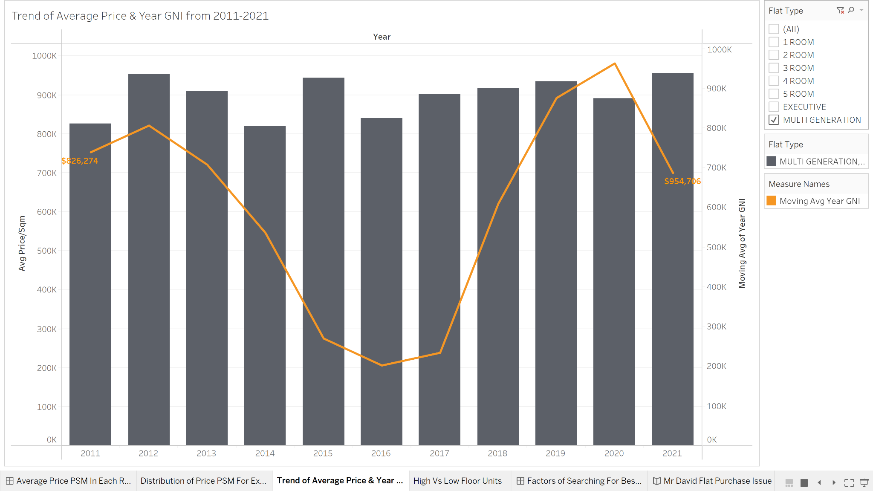
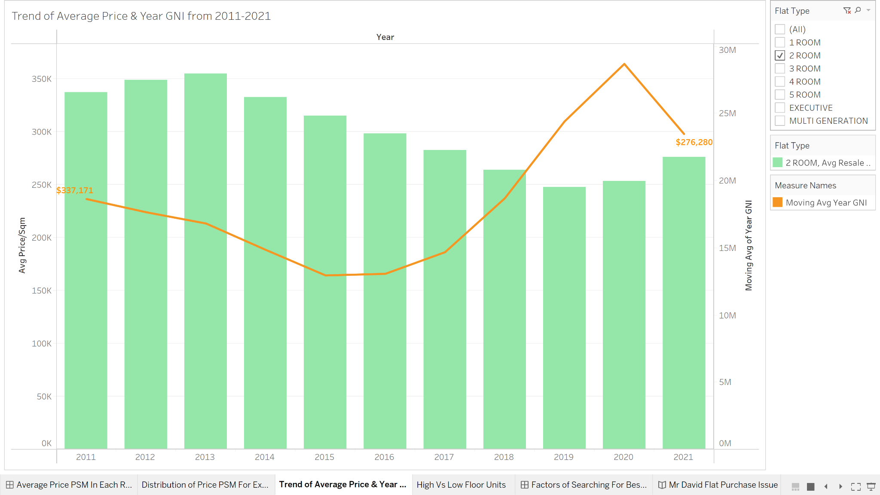
conclusion
Best Option For Mr David:
(Executive Flat) in Sembawang
4.37K
$108 psm
After comparing all the towns which flats average price psm falls below the median flat price psm and those median flats price psm that falls below the average median flats for every towns in SG, we can confirm that Sembawang flat has the most valued high level executive flat and Mr David can save about $1.63K psm from his budget.
The year GNI falls below the average resale price psm for every flat type in 2021 with the exception of 2-room flats, which means many Singaporeans will be unable to afford flats to live in.
One suggestion: Government can include more financial schemes and grants for all flat types except for 2-room flats.
2 Things I Have Learnt: 1) How to use Tableau to create charts to produce visual representations efficiently
2) How to identify trends, patterns and outliers in real life data sets to come up with analysis

Slide 11
References
Regions of Singapore, 2022 [online]. Available from: https://en.wikipedia.org/wiki/Regions_of_Singapore [Accessed 19 Nov 2022]
HDB unit Elevation-Ground floor,low floor,mid-floor and high floor, 2022 [online]. Available from: https://singaporepublichousing.fandom.com/wiki/HDB_unit_Elevation-Ground_floor,low_floor,mid-floor_and_high_floor#:~:text=Generally%2Cproperty%20agents%20consider%20high,buffer%20them%20from%20direct%20sunlight [Accessed 22 Nov 2022]

Slide 12
Thank you!
Do you have any questions?

